Slide 1
AnomiGAN: Generative adversarial networks for anonymizing private medical data
Published by Ho Bae, Dahuin Jung and Sungroh Yoon
Presented by Jiali Wang

Slide 2
Introduction
Background
The importance of this problem
What has been done already
The contributions of the authors
Methods
Method descriptions
Results
Data summary
Method comparison
Accuracy measure

Slide 3
Personal medical data usually have sensitive information that is subject to the risk of exposure.
E.g. a short DNA sequence can reveal one’s identity and relatives
Such data collection is necessary for researchers.
E.g. disease prevention and treatment
It leaves some information protection/preservation measure to be desired, such as Anonimized Generative Adversarial Networks (AnomiGAN).

Slide 4
Introduction
Background
The importance of this problem
What has been done already
The contributions of the authors
Methods
Method descriptions
Results
Data summary
Method comparison
Accuracy measure

Slide 5
The Value of Privacy: Ethical Reasons
According to Joy L. Pritts in his paper, it promotes fundamental values, including personhood such as: (http://www.nationalacademies.org/hmd/~/media/Files/Activity%20Files/Research/HIPAAandResearch/PrittsPrivacyFinalDraftweb.ashx)
Personal autonomy (the ability to make personal decisions)
Individuality
Respect
Dignity and worth as human beings

Slide 6
Biological Reasons
According to this paper, one’s medical information leak is dangerous because of the following logic:
An individual’s genetic information is static
A Genetic marker (e.g. short DNA sequence) can be a key to uniquely identify a person’s identity and the relatives
Leads to genetic discrimination issue
Denial of insurance
Blackmail (plant fake evidence at crime scenes)

Slide 7
Scene Introduction
Patient data sometimes is shared among medical institutions
There are public gene databases for rare gene diseases
Human Genome Project
Research Program (U.S.)
Genomics England (U.K.)
Patient portal and telehealth programs available as online health services with two major types of privacy threats:
Hijacking during transmission
Privacy leak on storage

Slide 8
The scenario consists of two parts—trusted zone and untrusted zone.
The trusted zone has no threats from an adversary. It’s where AnomiGAN can be deployed.
The untrusted zone has two parts— online medical services and third parties (Google, Amazon and Dropbox).
User data is transferred to online medical services which will provide diagnostic results, then the results will be stored in third parties on user’s consent.

Slide 9
This paper focuses on two types of adversaries in online health services
Active
Targets an individual’s private data during the interaction on the fly with the service
Passive
Targets any information stored online or offline services
There are also two types of issue related to passive adversaries
Private leak due to security level in the system
Patient information for medical researches upon their consents

Slide 10
AnomiGAN allows a user to adjust the anonymization level to their likings.
Also helps ensure minimal anonymity by reducing confidential level, in order to promote data sharing between institutions with the same privacy guidelines.
Confidence level relies on the δ acting like δ-differential privacy method (Dwork and Pottenger, 2013)
Non-deterministic model by variance addition

Slide 11
Introduction
Background
The importance of this problem
What has been done already
The contributions of the authors
Methods
Method descriptions
Results
Data summary
Method comparison
Accuracy measure

Slide 12
Approaches to Improve Protection of Personal Medical Data
Statistical-based anonymization
Relies on strong assumptions of the background population (Simmons and Sahinalp, 2019)
Differential Privacy (DP) is a state-of-the-art method to guarantee privacy (Dwork, 2011)
Limit: only applicable to a few genomic loci, could lead to inaccuracies when loci size goes up
No computational overhead
Encryption
Homomorphic encryption, allows for sharing of personal medical data with accuracy
Limit: Has a latency in the order of hundreds of seconds (Gilad-Bachrach et al., 2016)
A simple operation limits adaptation to a complex model, like NN (Bae et al., 2018)
Guarantees accuracy and preserves privacy, but has a bottleneck for computation complexity

Slide 13
Why GANs
To address these two issues, we present a method based on generative adversarial networks (GANs)
It preserves similar prediction performance, while can protect privacy

Slide 14
Introduction
Background
The importance of this problem
What has been done already
The contributions of the authors
Methods
Method descriptions
Results
Data summary
Method comparison
Accuracy measure

Slide 15
Explored whether a generative model can be constructed to produce meaningful synthetic data that simultaneously conducts information preservation and privacy protection
Evaluated a generic method on prediction classifiers for two diseases (breast cancer and chronic kidney disease)
Found that prediction performance degradation is minimal compared to the original prediction result
Compared the proposed method with the most advanced techniques, and provided analysis of privacy parameter and accuracy
Revealed that the model becomes unstable when using a non-robust, target classifier

Slide 16
Introduction
Background
The importance of this problem
What has been done already
The contributions of the authors
Methods
Method descriptions
Results
Data summary
Method comparison
Accuracy measure

Slide 17
The training model has three parts: an encoder, a discriminator and a target classifier (pretrained discriminator)
Encoder: trained with random noise to generate synthetic data close to the form of input data
Target classifier: places a prediction score of a synthetic data generated by the encoder
Discriminator: generates a confidence score to differ synthetic data from original one

Slide 18
Differential Privacy
DP is a privacy preserving model that guarantees to protect individuals from privacy loss from an adversary. It promises to minimize harm probability by adding noise to output:
$$M\left(Ɗ\right)=f\left(Ɗ\right)+τ$$
Where M: $Ɗ$ → ℝ is a random function that takes a noise τ to the output. $Ɗ$ is the target database, and $f$ is the deterministic original query response.

Slide 19
Definition (Differential Privacy)
A random algorithm M with domain ${\text{ℕ}}^{|D|}$ is δ-differentially private if for all S ∈ Range (M) and for D, $\hat{D}$∈ ${\text{ℕ}}^{|D|}$ such that D - $\hat{D}$ ≤ 1:
Pr [$M\left(Ɗ\right)$ ∈ S] ≤ exp(δ)Pr[M($Ɗ^{′}$) ∈ S]
Where $Ɗ$ and $Ɗ^{′}$ are the absolute value of the privacy loss that is bounded by δ with probability at least 1 – δ (Dwork et al., 2014)

Slide 21
Threat Model
A random oracle model (Canetti el al., 2004) posits the randomly chose function H, which can be evaluated only be querying an oracle than returns H(x) given input x. The security of the random oracle is based on an experiment with an adversary A, as well as A’s indistinguishability of the encryption. Assume that we have the random oracle acting like a current anonymous scheme E with only a negligible success probability.

Slide 23
The scheme E is perfectly secure over input space X if for every adversary A it satisfies
P(experiment of success) = $\frac{1}{2}$
Here A cannot distinguish between x0 and x1, nor can A obtain information about the presence of a hidden message. Since most system have no access to a random oracle in reality, pseudorandom functions are usually applied by replacing the random function (Canetti et al., 2004). With the assumption, the oracle is replaced by a fixed encryption scheme E, which corresponds to the transformation of a real system. The implementation of a random oracle is deemed secure if the probability of the success of a random oracle attach is negligible.

Slide 24
The encryption is soundness secure if adversary A has a success probability such that
P(experiment of success) ≤ $\frac{1}{2}$ + ε

Slide 25
The architecture of model training
XOR (exclusive or) is true only when an odd number of inputs are true.
The encoder accepts x and r as input and that are fed into the neural network. The discriminator takes an original input and output of the encoder to output probabilities from the logits (last fully connected layer). The target classifier takes an input $\hat{x}$ and outputs the prediction score.

Slide 26
Learning object of the encoder
Minimize discriminator’s probability to ½ and maximize the prediction score of the target classifier
The encoder accepts the n length of messages as input and generates the n length of random strings, that are fed in the neural network.
1st layer: consists of 64 filters with a length of 4
2nd layer: consists of 32 filters with a length of 2
3rd layer: consists of 16 filters with a length of 2
4th layer: consists of 8 filters with a length of 2
Additional layers: added to the reverse order to the number of input length n

Slide 27
Other features at each layer
batch normalization (Ioffe and Szegedy, 2015) and tanh (LeCun et al., 2012) as activation, except for the final layer where ReLU (Nair and Hinton, 2010) is used for activation
The discriminator uses the encoder’s output as the input to determine whether the output is real or generated.
A sigmoid function is used to output probabilities from the logits.

Slide 30
Security Principle of Anonimized GANs
AnomiGAN has a scheme indistinguishable to an adversary.
It is computationally secure, because its probabilistic model can generate pseudorandom output.
Intuition
An adversary is allowed to choose from multiple synthesized data, while for AnomiGAN, synthesized data is viewed as encrypted data.

Slide 31
Proof
Construct input as a seed k ∊ ${\text{\{0, 1\}}}^{n}$ and a medical record x ∊ ${\text{\{0, 1\}}}^{n}$, where r ← ${\text{\{0, 1\}}}^{n}$ is chosen at random and outputs synthesized data.
Define anonymization scheme as follows for medical record length n:

Slide 32
Theorem
If F(k) is a pseudorandom generator and M is a probabilistic model, then M has a scheme that is indistinguishable to an adversary.
Proof rationale
If M is a probabilistic and the F(k) is the pseudorandom generator, then the resulting scheme is identical to the one-time pad encryption scheme in Slide 22.

Slide 33
Results
Operation system: Ubuntu 14.04
CPU: Intel i7-5930K @ 3.5GHz
GPU: GTX Titan X Maxwell (12GB)
Packages:
Scikit-learn (v 0.18 for CNN), Keras (v 2.0.6 for NN), tensorflow (v 1.11.0 for GAN) and bio-ython (v 1.72 for input representation)

Slide 34
Dataset
Wisconsin breast cancer dataset
UCI machine learning repository (Blake, 1998), with 30 features
Randomly partitioned to raining and test sets of 90% and 10%
Chronic kidney disease dataset
UCI machine learning repository (Rubini and Eswaran, 2015), with 24 features
Randomly partitioned to raining and test sets of 90% and 10%

Slide 35
Target Classifiers
Kaggle competitions
Breast cancer
Chronic kidney disease
Two reasons
Both classifiers achieve high accuracy in disease detection to their datasets
Open source implementations with easy access

Slide 36
Model Training
Multi-class logarithmic loss function Adam (Kingma and Ba, 2014)
Learning rate = 0.001
Beta rate = 0.5
Epoch = 50000
Mimi-batch size = 10
Discriminator achievements
Breast cancer: 3000 steps after the optimal loss
Chronic kidney disease: 10000 steps after the optimal loss

Slide 37
Evaluation Process
Used the Laplacian mechanism to compare the anonymization against corresponding accuracy and AUC
Correlation coefficient
Measure linear relationship between the original and anonymized samples
Data generation
Anonymized data
Randomly selected 1000 cases
Calculation
Average prediction of accuracy, AUC, correlation coefficient
Model validation
A variance of each encoder layers is added
Repeated 1000 times with fixed test data

Slide 38
Introduction
Background
The importance of this problem
What has been done already
The contributions of the authors
Methods
Method descriptions
Results
Data summary
Method comparison
Accuracy measure

Slide 39
Comparison to Differential Privacy
Noise presents a trade-off between accuracy and privacy
Add Laplacian noise Lap (λ) = Lap (S/δ) to a statistics (Dwork and Pottenger, 2013)
λ = 0.1, which has a minimal effect on privacy
Risk increases as λ increases

Slide 40
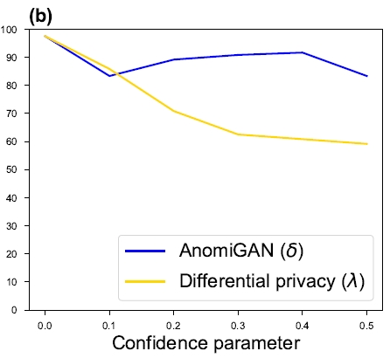
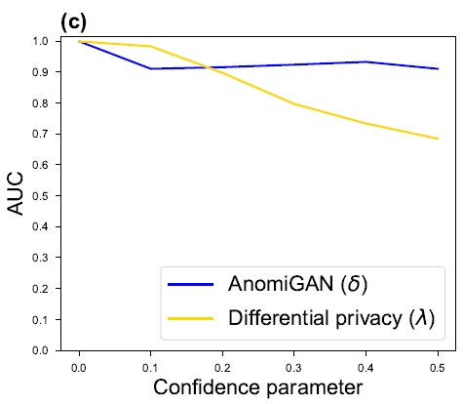
Parameter Comparison of Breast Cancer

Slide 41
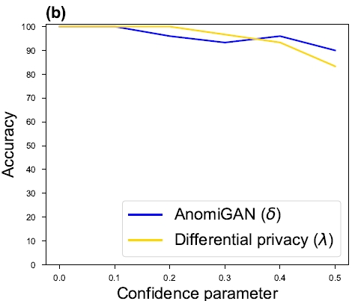
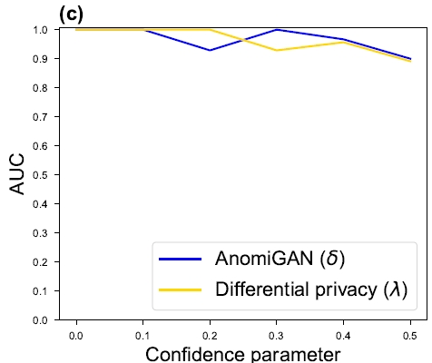
Parameter Comparison of Chronic Kidney Disease

Slide 42
Introduction
Background
The importance of this problem
What has been done already
The contributions of the authors
Methods
Method descriptions
Results
Data summary
Method comparison
Accuracy measure

Slide 43
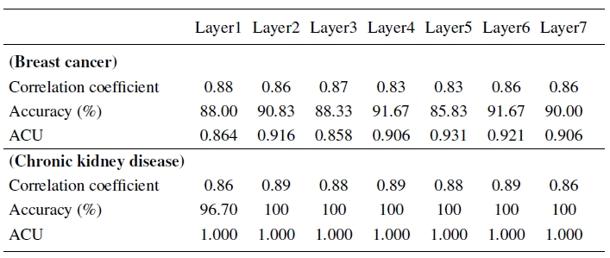
Performance Comparison
Performance results of the model upon adding variance to the layer

Slide 44
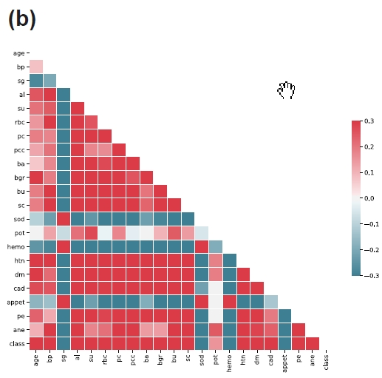
Correlation between features of both diseases
Breast cancer
Chronic kidney disease

Slide 45
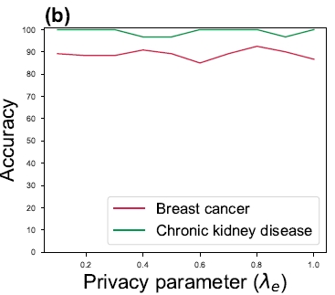
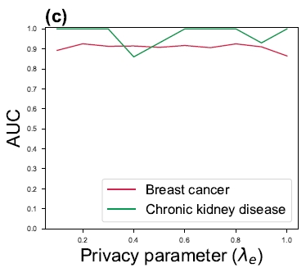
Comparison of privacy parameter ${\text{λ}}_{e}$

Slide 46
Training and running time

Slide 47
Conclusion
This novel approach is secure against an efficient adversary, mathematically
Has a better performance of accuracy and AUC than DP, while preserving privacy
Not statistics-based, needs no background population for good prediction
Can share data while having minimal privacy risks
Predicts a trend of the application of deep NN in online medical services
Want to extend it to genomic data

